Slide 1




UNDERWATER CHANNEL CHARACTERIZATION FOR SHALLOW WATER MULTI-DOMAIN COMMUNICATIONS
International Conference on Underwater Acoustics ICUA 2020
Jay Patel, Mae Seto
Faculty of Engineering,
Dalhousie University, Canada
Funded by :
Notes:
Welcome to ICUA 2020. My name is Jay Patel, currently pursuing my PhD in Electrical & Computer Engineering in Dalhousie University. Today I am going to give a brief presentation on “UNDERWATER CHANNEL CHARACTERIZATION FOR SHALLOW WATER MULTI-DOMAIN COMMUNICATIONS”.

Slide 2
Outline
Introduction
Conclusion
References
Background
Methodology & Demo
Simulation and Results
Notes:
These are the outline of my presentation today. First I am going to talk about some introduction and background of the topic and then we are going to discuss methodology that we used to carry out this research and finally we would see some interesting simulation results and small demo of MATLAB Graphical User Interface made for the project and small clips of simulation and in-water testing of the project.

Slide 3
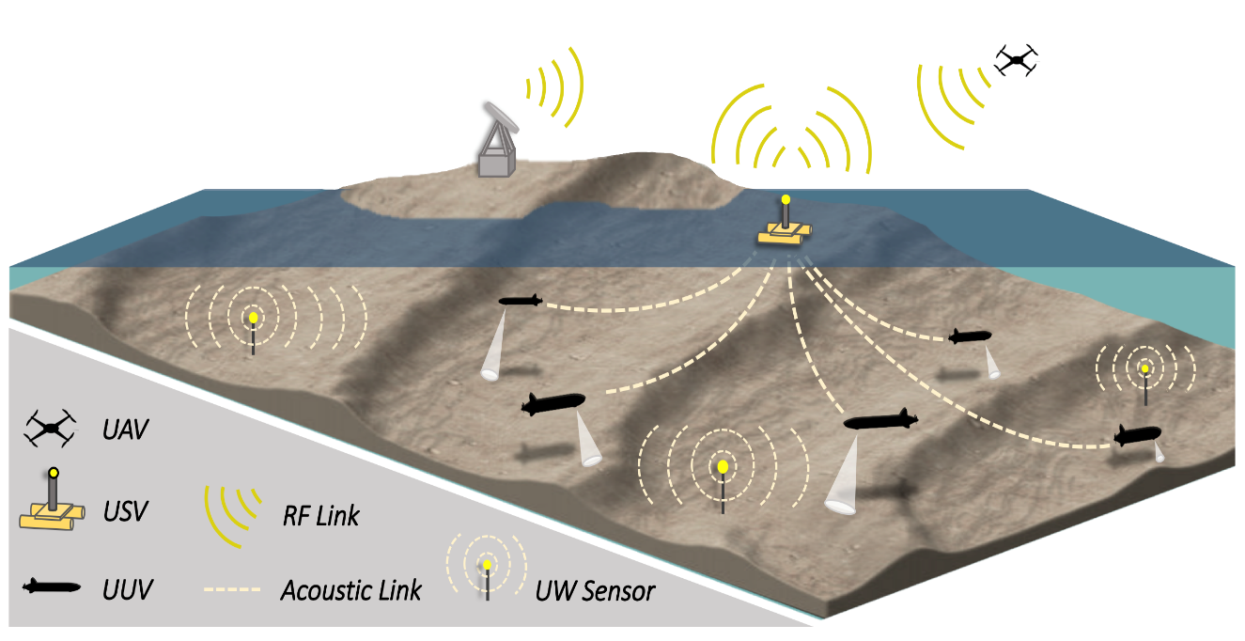
Problem definition for research project
Simulation of an underwater acoustic channel with environmental parameters supplied to Bellhop to predict performance of an underwater channel, simulations focussed on Bedford Basin, Canada - shallow water with muddy bottoms at various water depths.
solution: Bellhop modeling
Provides an estimated operating range and depth for UUV⁺ deployment for simulations on multi-domain marine robots communications for above and below-water surveillance and characterization of floating marine objects.^{[1]}
⁺ unmanned underwater vehicle
Figure 1: Robotic multi-vehicle collaboration –above and below water ^{[7]}
Notes:
As we all know the most difficult nodes are the underwater robots which communicate acoustically, which have limited bandwidth, and limited range due to unstable link quality which vary spatiotemporally. We had completed this project under DND research project - Collaboration of Multidomain robots towards above and below water surveillance and characterization of marine object, collaboratively with Cellula Robotics. 2020 is new era of business where the most important asset is “information” itself. So overall objective of the project is to Tx findings from underwater domain using robot networks, relay that information to the surface vehicle to above water aerial vehicle. OR To send above water instructions to underwater robot network and vice versa.
As you can see Underwater Acoustic sensor network can consists of sensors on UUV and USV to perform certain collaborative monitoring task or some surveying task or detecting a floating object etc.
But Before deploying any kind of vehicles underwater, one should predict the underwater communication system performance which is based on the sound frequency transmitted underwater.
Why do you need to analyze the uw-communication network performance?
because main thing deploying robot network underwater is expensive. You can save more money and time if you have somewhat prior knowledge of your operational range, which indeed provide you a rough idea about how far you can communicate with the existing environmental conditions.

Slide 4
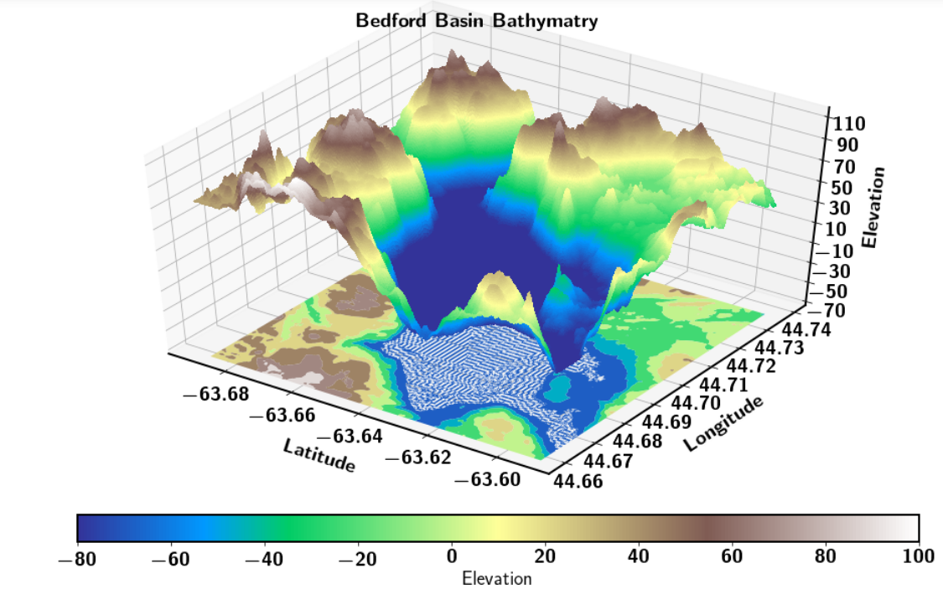
Simulation objectives (1 / 2)
concept of operation: heterogeneous marine robots (unmanned underwater vehicle (UUV), unmanned surface vehicle (USV), and unmanned aerial vehicle (UAV)) collaboratively acquire situational awareness on a floating target
analyze impact of channel characteristics on underwater communications
Figure 2: Bathymetry of Bedford Basin - Halifax, Canada
Notes:
So we had carried out few simulation to analyze impact of channel characteristics on underwater comms before we actually go and deploy our uw-robot network in Bedford Basin, Halifax. To overcome this problem, we decided to use Bellhop and its ray tracing models to do some simulations for underwater sound propagation. Estimating operational range and link budget calculation for UUV deployment is the most critical part of the project.
So the concept of the operation here is “heterogeneous marine robots (unmanned underwater vehicle (UUV), unmanned surface vehicle (USV), and unmanned aerial vehicle (UAV)) collaboratively acquire situational awareness on a floating target” which could be either our area of interest, a mine or fish or could be anything. This is a Digital Arc of our Bedford basin.

Slide 5
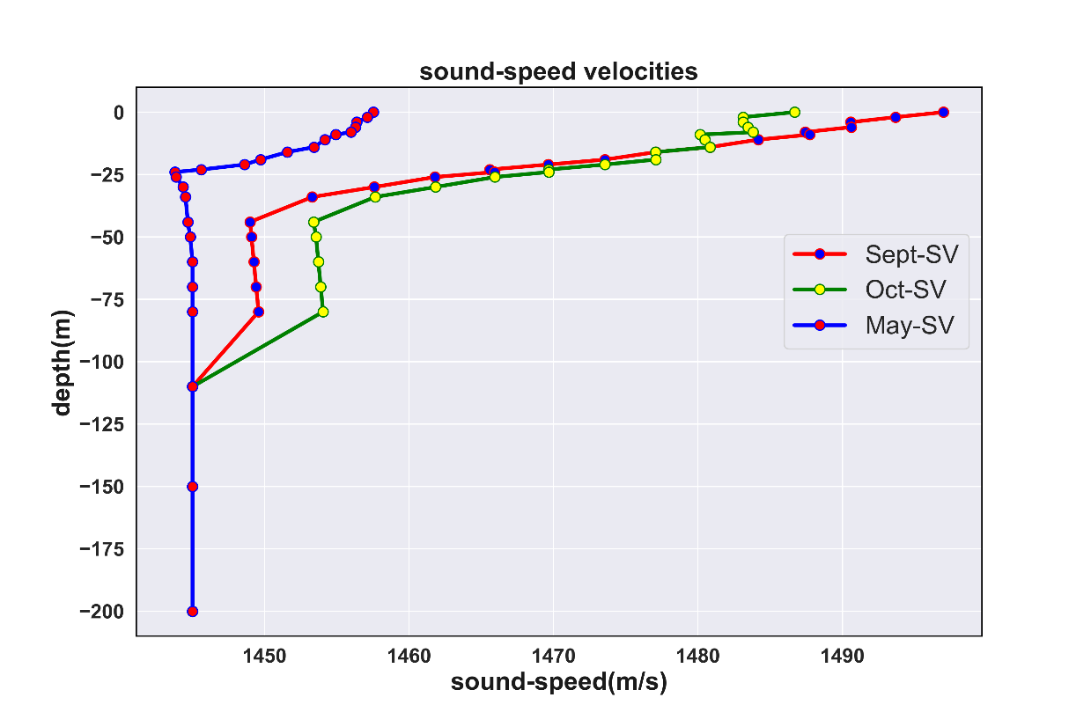
Simulation objectives (2 / 2)
prior to deploying robots, predict communication system performance
provide guidance on best physical layout to deploy underwater vehicles
provide estimates on parameters for link budget calculation
Figure 3: sound-speed profile of Bedford Basin used for simulation test cases
Notes:
Here are some of the SSP measured at Bedford Basin, Halifax during various time of the year which are being used in most of the simulation cases.

Slide 6
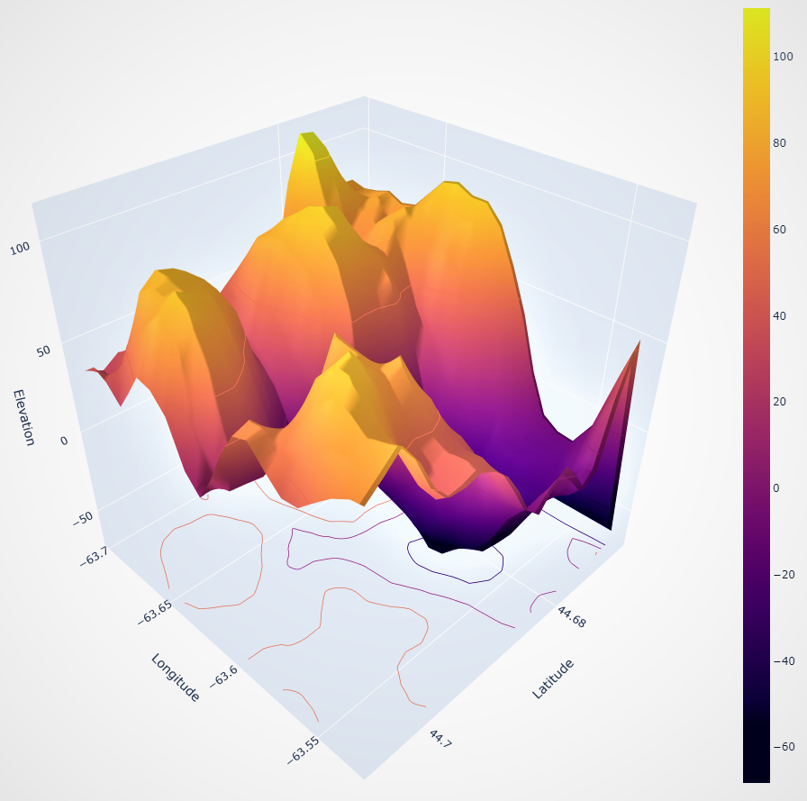
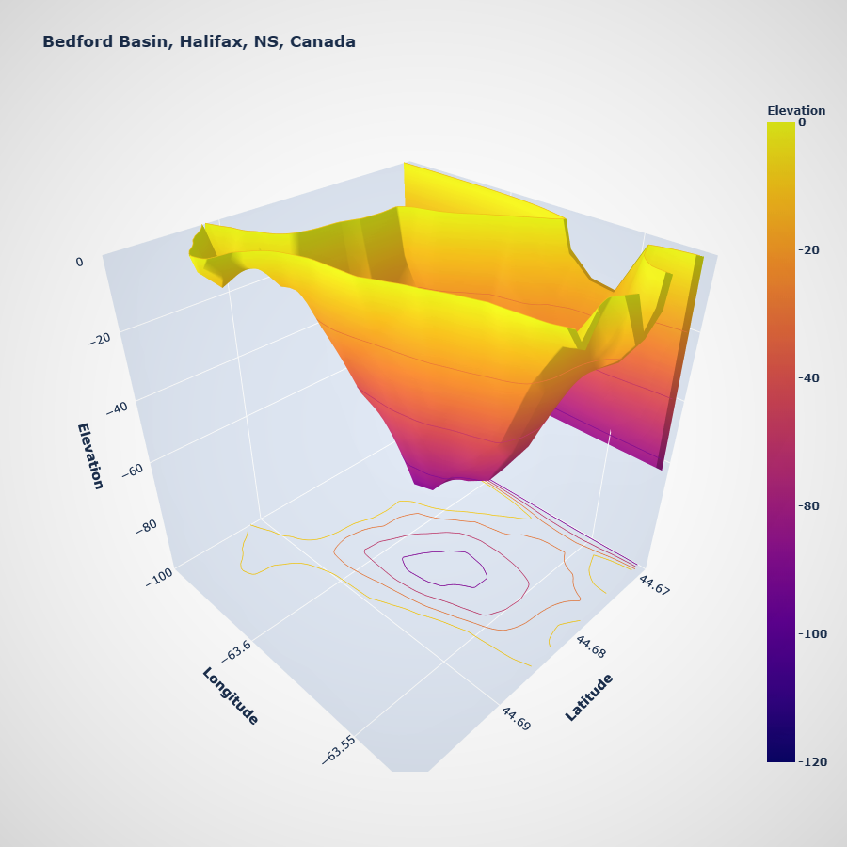
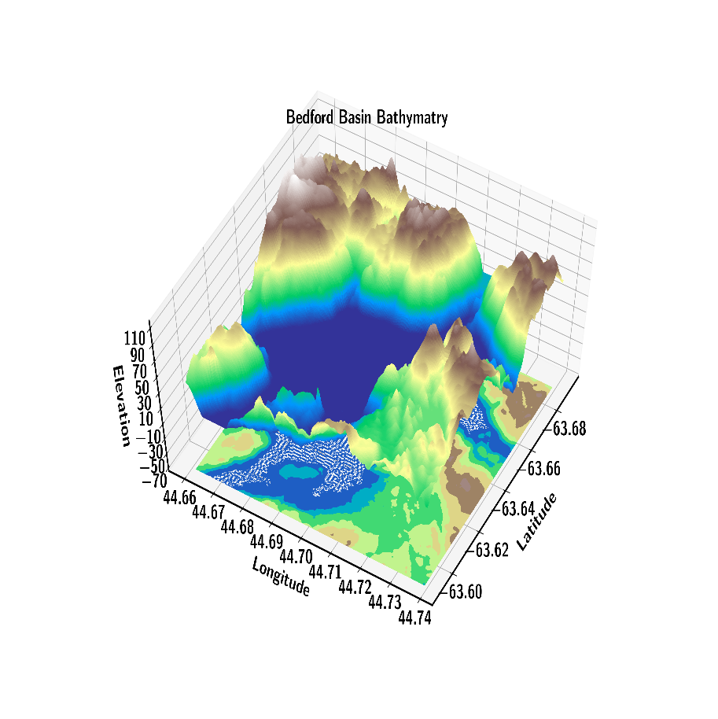
Bedford Basin bathymetry used for simulation cases
Figure 4: Detailed Bathymetry of Bedford Basin - Halifax, NS, Canada
Notes:
Here are some interesting view of Bedford Basin, Halifax which are being supplied in bellhop for more accurate simulations.

Slide 7
Relevant References from Literature Survey
Table 1: relevant literature survey
Sr No | Title | Authors | Published in
1. | Simulation and experimentation platforms for underwater acoustic sensor networks: Advancements and challenges^{[1]} | Hanjiang Luo, KaishunWu, Rukhsana Ruby, Feng Hong, Zhongwen Guo, and Lionel M. Ni. | ACM Comput. Surv. 50, 2, Article 28 (May 2017), 44 pages
2. | Analysis of Simulation Tools for Underwater Sensor Networks (UWSNs) ^{[2]} | Nayyar A., Balas V.E. | Bhattacharyya S., Hassanien A., Gupta D., Khanna A., Pan I. (eds) International Conference on Innovative Computing and Communications. Lecture Notes in Networks and Systems, vol 55. Springer, Singapore, March 2019
3. | A CDMA-based Medium Access Control for UnderWater Acoustic Sensor Networks^{[3]} | D. Pompili, T. Melodia and I. F. Akyildiz | IEEE Transactions on Wireless Communications, vol. 8, no. 4, pp. 1899-1909, April 2009
4. | Comparative analysis of routing protocols for under-water wireless sensor networks^{[4]} | Hala Jodeh, Aisha Mikkawi, Ahmed Awad, and Othman Othman. | Proceedings of the 2nd International Conference on Future Networks and Distributed Systems (ICFNDS '18). ACM, New York, NY, USA, Article 33, 7 pages.
5. | Embedded systems for prototyping underwater acoustic networks: The DESERT Underwater libraries on board the PandaBoard and NetDCU^{[5]} | I. Calabrese, R. Masiero, P. Casari, L. Vangelista and M. Zorzi, | 2012 Oceans, Hampton Roads, VA, 2012, pp. 1-8.
Notes:
Here are some of the most relevant literature reviewed for the project. You can refer those for more details.

Slide 8
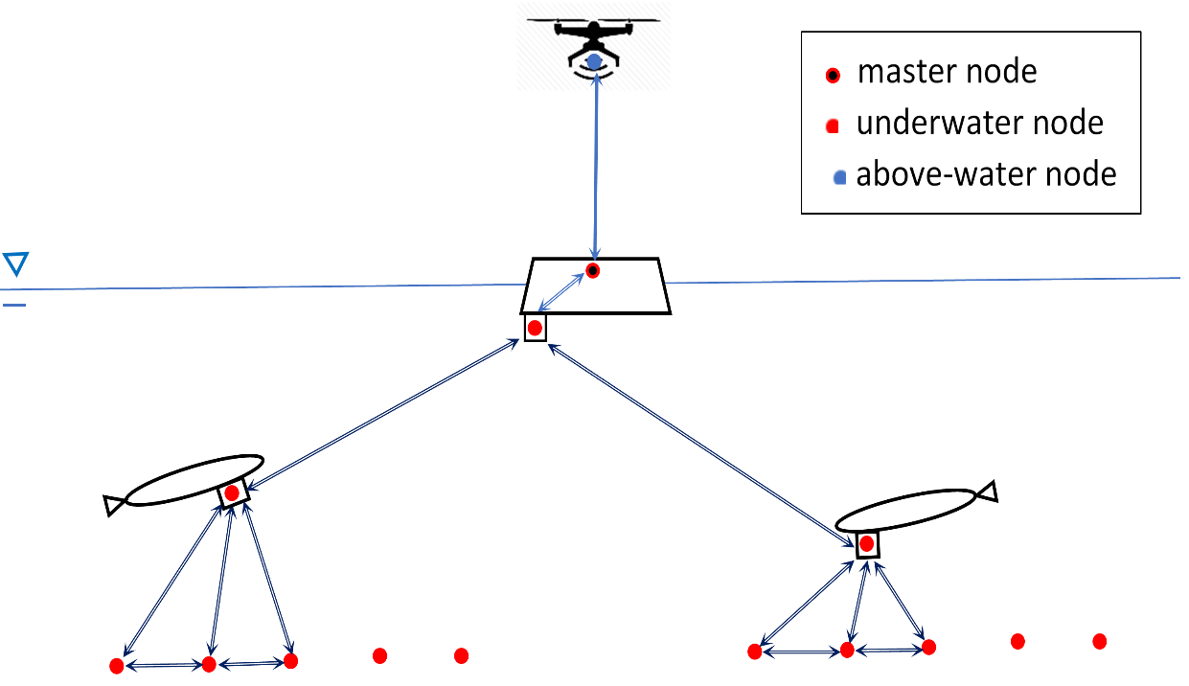
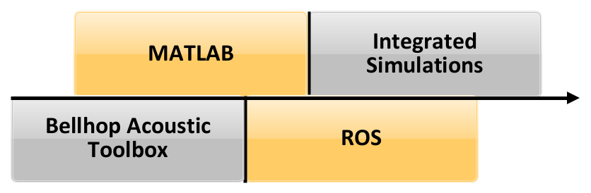
Methodology (1 / 3)
Custom MATLAB based GUI⁺ is being used collaboratively for simulation of various test cases.
⁺ graphical user interface
Figure 6: Software framework
Figure 5: Heterogeneous marine sensor
network architecture
Notes:
As I am suggesting that relaying information from one domain to another would be quite complex so we come up with the integrated solution for our problem in which we use MATLAB, ROS and Bellhop Acoustic Toolbox.

Slide 9
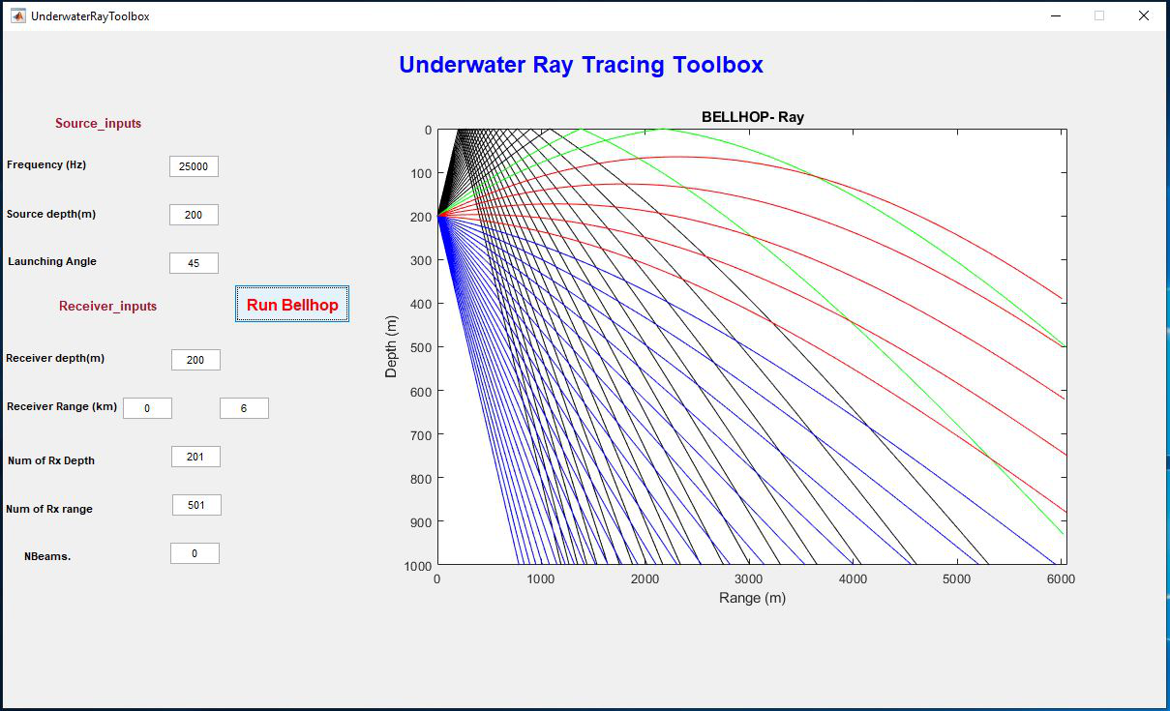
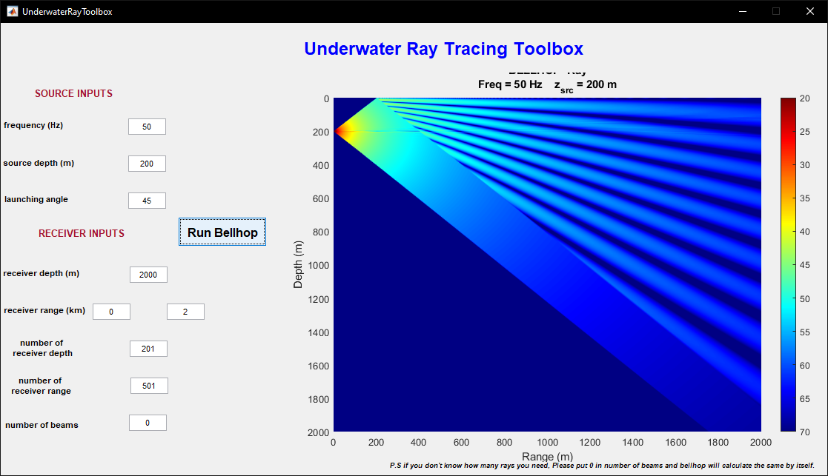
Methodology (2 / 3)
GUI used MATLAB App building Toolbox, planning to open source it soon to the community.
Figure 7: Ray Tracing from Underwater
Ray Tracing Toolbox – MATLAB custom GUI ⁺
Figure 8: Transmission loss from Underwater
Tracing Toolbox – MATLAB custom GUI ⁺
Notes:
This is the Graphical User Interface that we developed for the project, where user can directly put the input environmental parameters and It will automatically generate env file for bellhop run and Plot the output as you requested. You can see some of the cases which were being simulated using GUI. GUI has been developed using MATLAB App Building Toolbox.

Slide 10
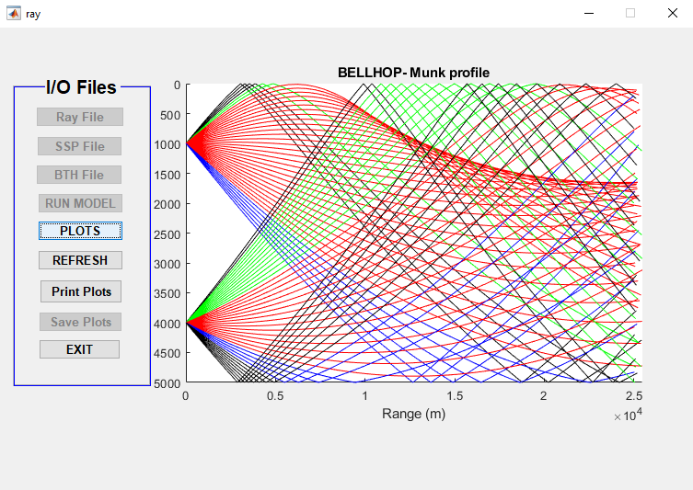
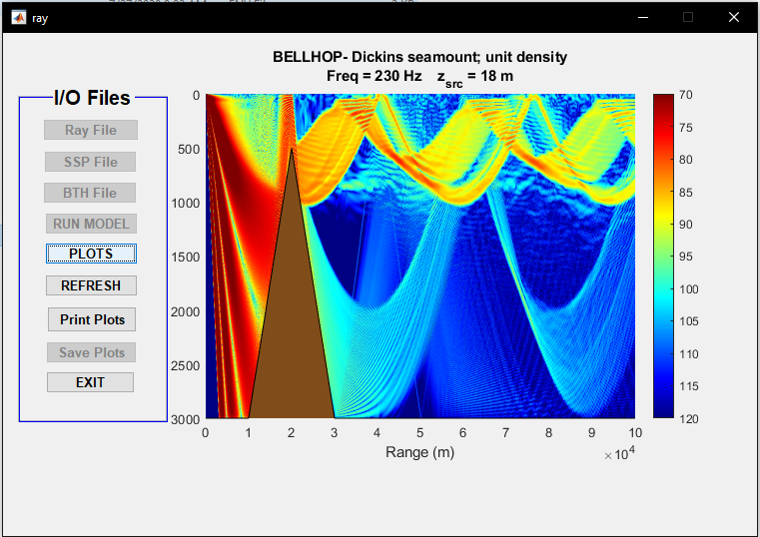
Methodology (3 / 3)
GUI used MATLAB App building Toolbox, planning to open source it soon to the community.
Figure 9: Ray Plotting using Underwater Ray Tracing
Toolbox – Plotting Toolbox
Figure 10: TL plotting using Underwater Ray Tracing
Toolbox – Plotting Toolbox
Notes:
UW-Ray tracing toolbox also come with plotting toolbox named “Ray”, which takes files as an input and plot the requested data. It also has capabilities to capture the snapshot of the GUI itself and saving the generated plot as *.m file.

Slide 11
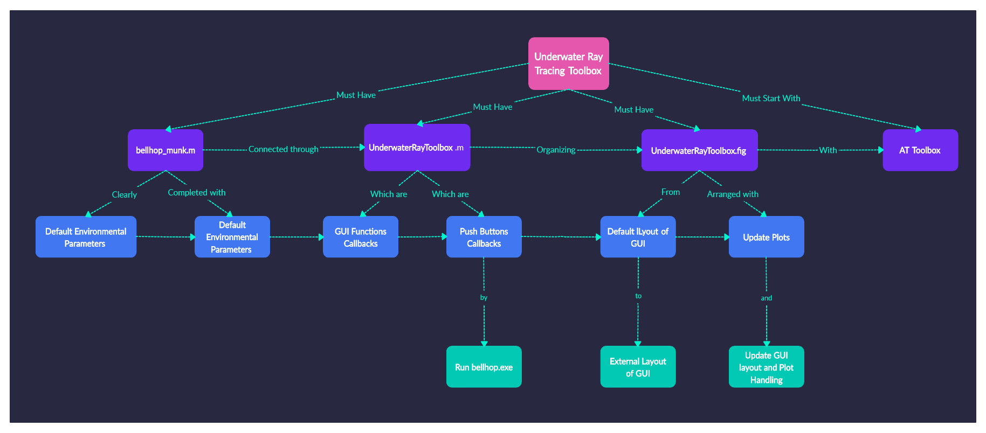
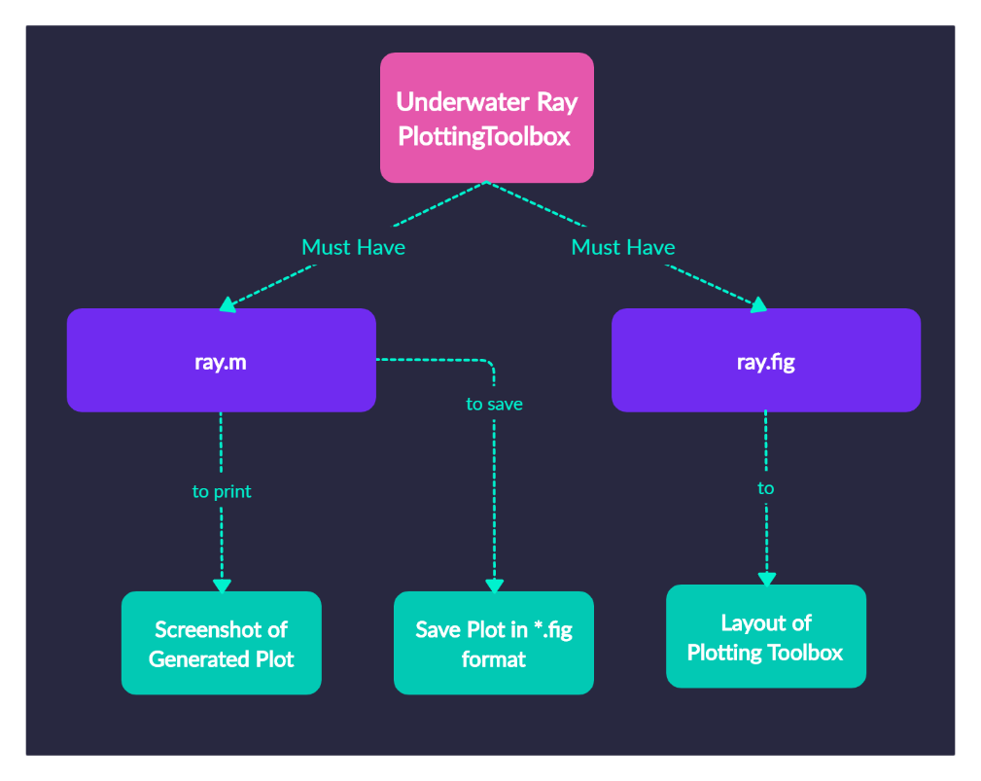
File Structure
Figure 11: File structure of Underwater Ray Tracing Toolbox
Figure 12: File structure of Underwater Plotting Toolbox
Notes:
Here is the basic file structure of the Toolbox. When you run the Underwater Acoustic Ray Toolbox, It will open multiple threads in your system and calls multiple MATLAB functions to run your bellhop simulations. This toolbox is heavily depend on newer version of AT Toolbox.

Slide 12
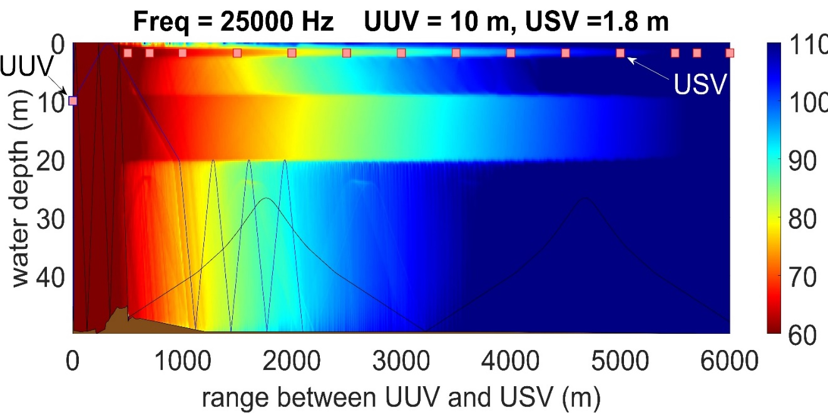
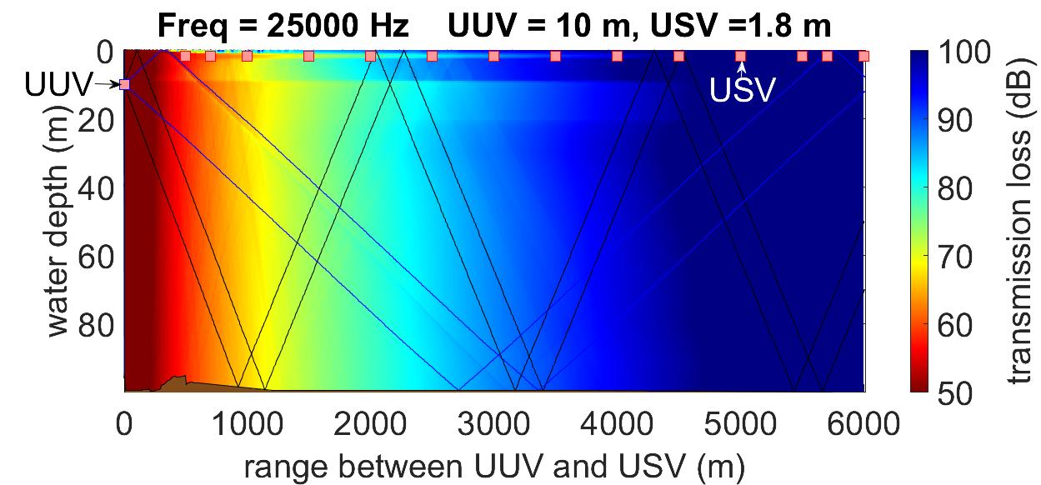
Bellhop Simulation Results (1 / 3)
Table 2: System parameters to simulate
parameter | value
frequency | 25 kHz
water depth | 50,100 m
range | 0-6 km
USV uw modem depth | 1.8 m
UUV depth | 10 m
Figure 9: Ray Traced and TL with water depth = 50 m
from predicted transmission loss to determine the optimal range (function of water depth, UUV depth = 10 m)
Figure 10: Ray traced and TL with water depth = 100 m
Notes:
We ran few most relevant scenarios of the simulations where we put our UUV at 10 m depth and USV has towed body at depth 1.8 m below the water level and then we varies these node at the different location of Bedford basin where water depth are 50 m, 100 m, 150 m, 200 m. Simulation has been carried out for the frequency 25 KHz for range 6 KM(which is radio horizon for ocean).

Slide 13
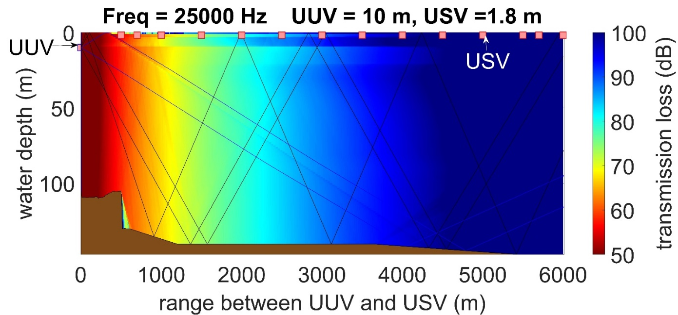
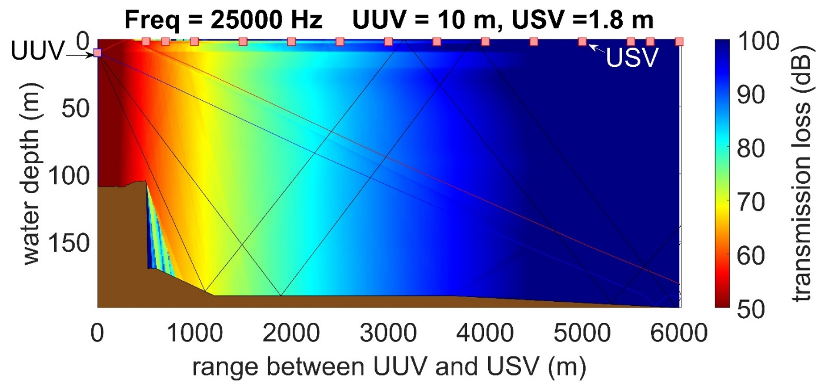
Bellhop Simulation Results (2 / 3)
Table 3: System parameters to simulate
parameter | value
frequency | 25 kHz
water depth | 150,200 m
UUV-USV range | 0-6 km
USV uw modem depth | 1.8 m
UUV depth | 10 m
Figure 11: Ray Traced and TL with water depth = 150 m
from predicted transmission loss can determine the optimal range (function of water depth, UUV depth = 10 m), 0 – 6 km range)
Figure 12: Ray Traced and TL with water depth = 200 m
Notes:
We ran few most relevant scenarios of the simulations where we put our UUV at 10 m depth and USV has towed body at depth 1.8 m below the water level and then we varies these node at the different location of Bedford basin where water depth are 50 m, 100 m, 150 m, 200 m. Simulation has been carried out for the frequency 25 KHz for range 6 KM(which is radio horizon for ocean).

Slide 14
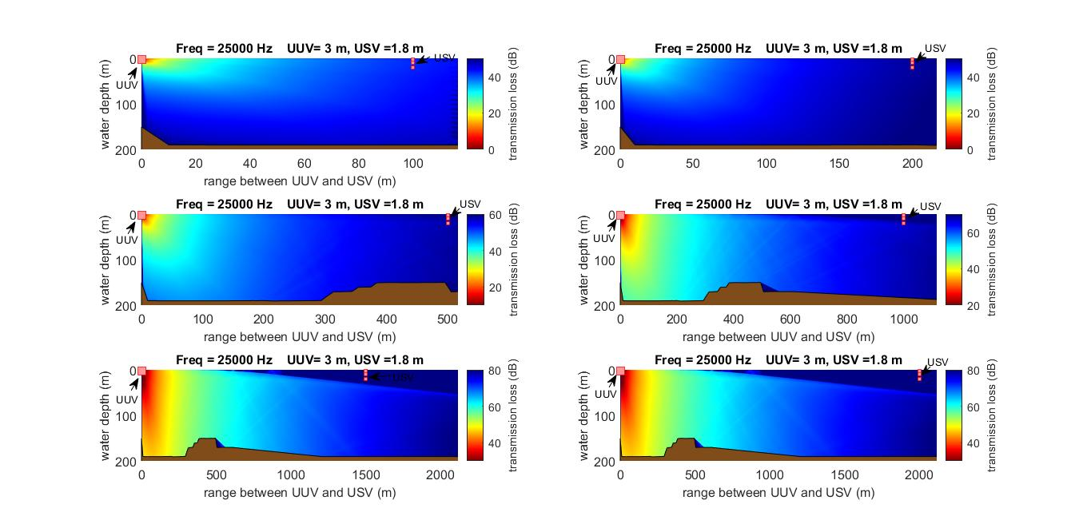
Bellhop Simulation Results (3 / 3)
Table 4: System parameters to simulate
parameter | value
frequency | 25 kHz
water depth | 200 m
UUV-USV range | 0-2.2 km
USV uw modem depth | 1.8 m
UUV depth | 3 m
range between UUV and USV (m)
from predicted transmission loss can determine the optimal range (UUV depth = 3m, UUV-USV range = 0 – 2.2km)
Figure 13: Transmission loss at water depth = 200 m starting from top left corner - for ranges: i) 100 m; ii) 200 m; iii) 500 m; iv) 1 km; v) 1.5 km, and vi) 2.2 km
Notes:
Another scenario explored where UUV is deployed at 3m and USV is deployed at 1.8m below the water surface.

Slide 15
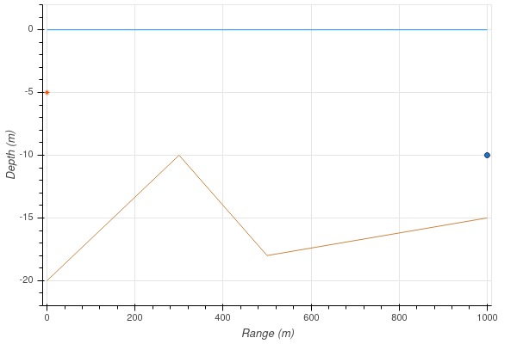
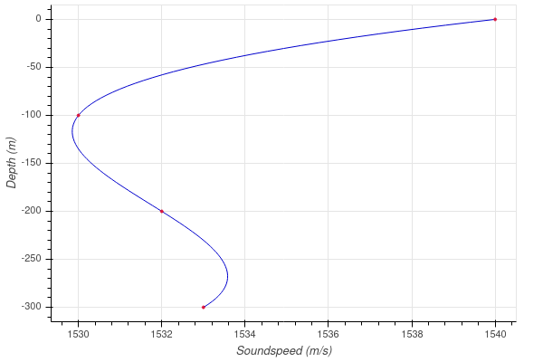
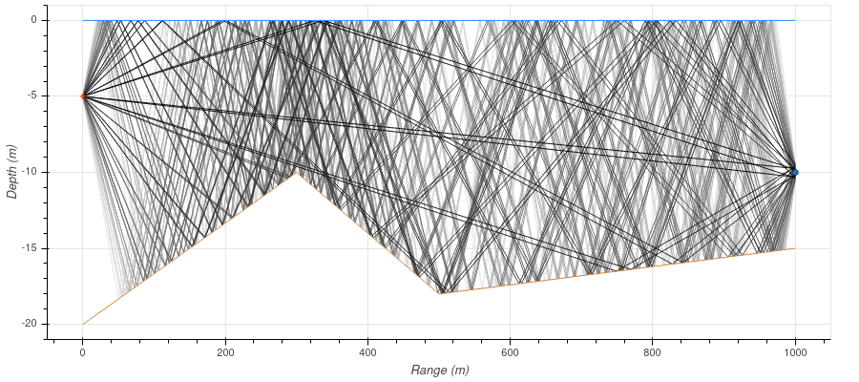
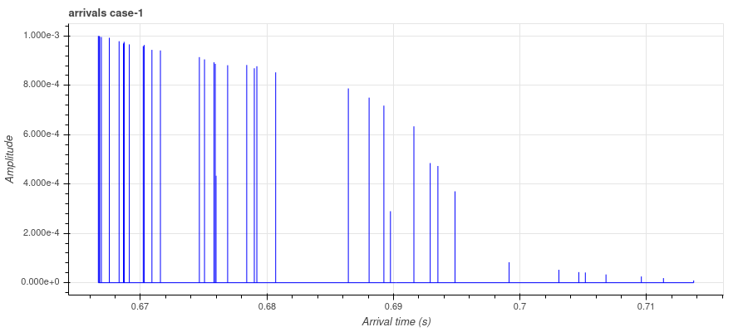
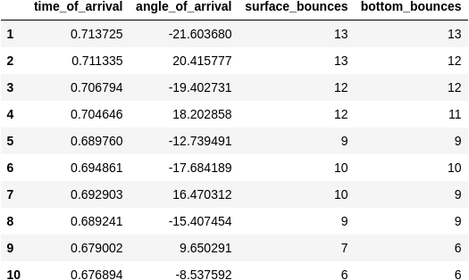
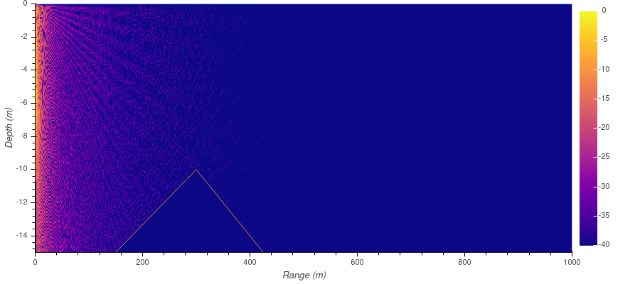
More test cases explored using ARLPY toolbox (1 / 5)
Figure 14: For water depth = 20 m; Tx=5m; Rx= 10m starting from top left corner - i) UW-env; ii) SSP; iii) Eigen rays; iv) arrivals; v) information of first 10 arrivals, and vi) coherent TL ^{[9]}
Notes:
We had also explored and validate that with the more test cases using ARLPY toolbox which is a python wrapper for Bellhop Toolbox.

Slide 16
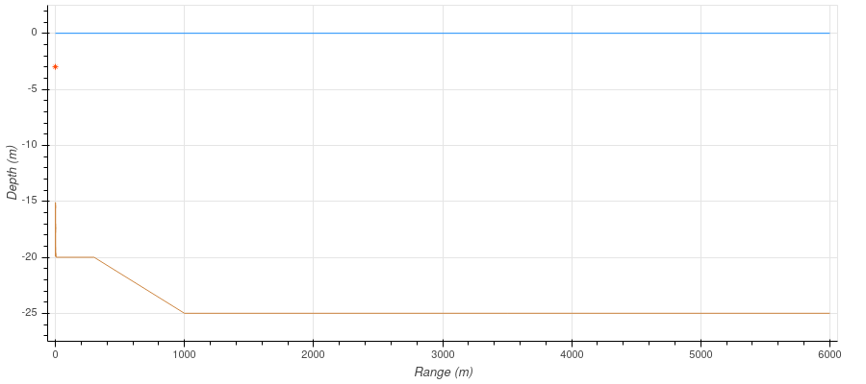
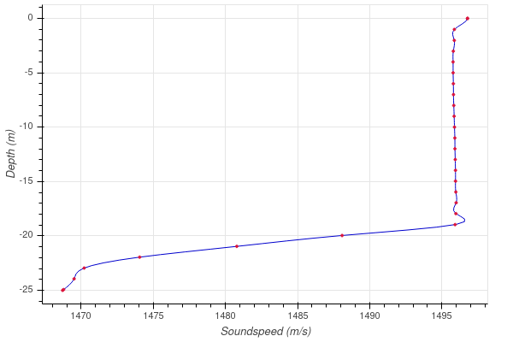
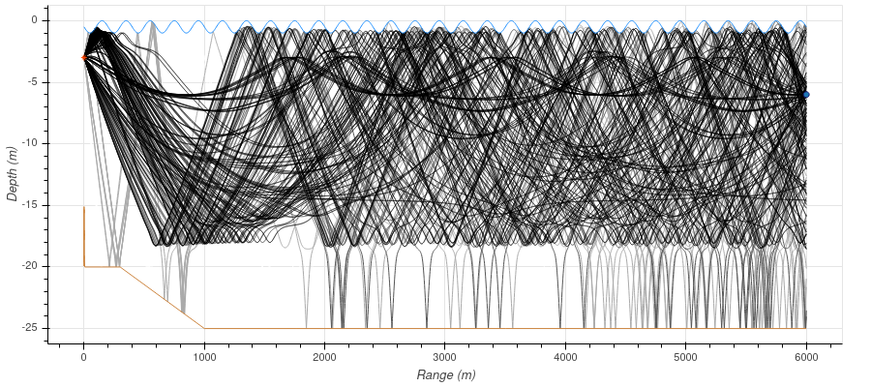
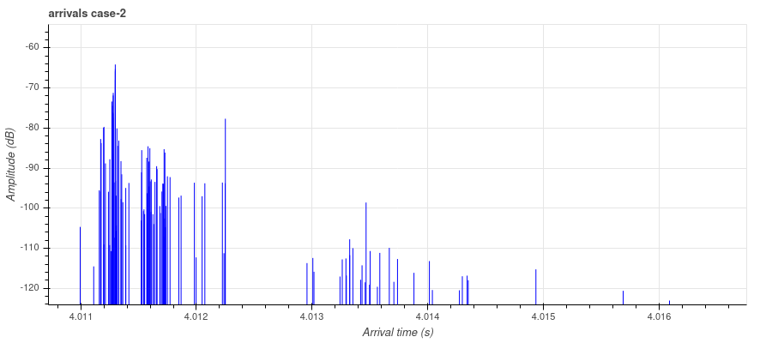
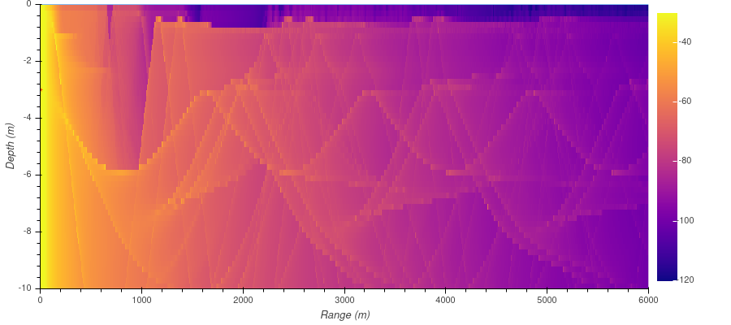
More test cases explored using ARLPY toolbox (2 / 5)
Figure 15: For water depth = 20 m; Tx=3m; Rx= 10m starting from top left corner - i) UW-env; ii) SSP; iii) Eigen rays; iv) arrivals; v) information of first 10 arrivals, and vi) incoherent TL ^{[9]}
Notes:
We had also explored and validate that with the more test cases using ARLPY toolbox which is a python wrapper for Bellhop Toolbox.

Slide 17
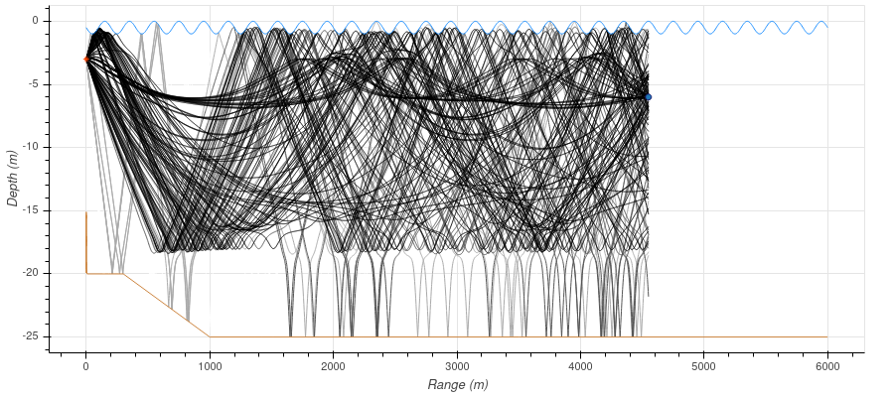
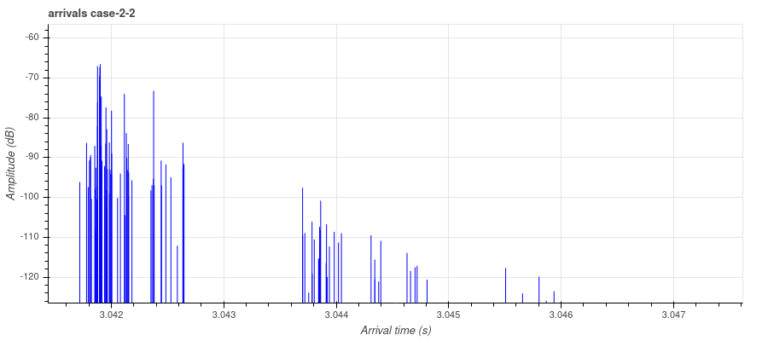
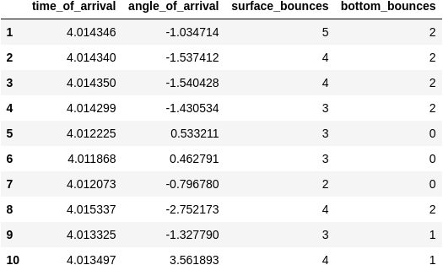
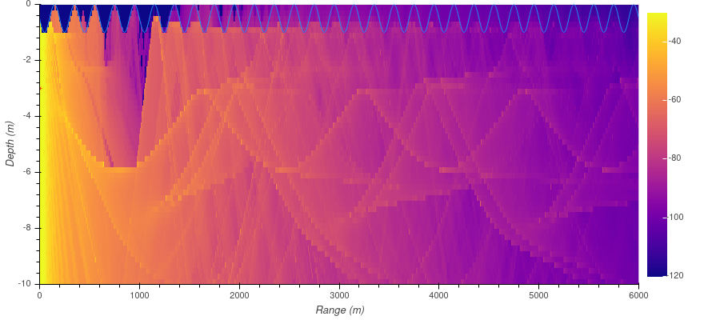
More test cases explored using ARLPY toolbox (3 / 5)
Figure 16: For water depth = 20 m; Tx=3m; Rx= 6m starting from top left corner - i) UW-env; ii) SSP; iii) Eigen rays; iv) arrivals; v) information of first 10 arrivals, and vi) incoherent TL ^{[9]}
Notes:
We had also explored and validate that with the more test cases using ARLPY toolbox which is a python wrapper for Bellhop Toolbox.

Slide 18
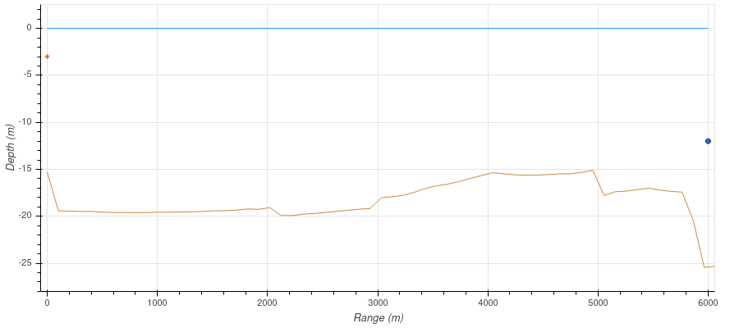
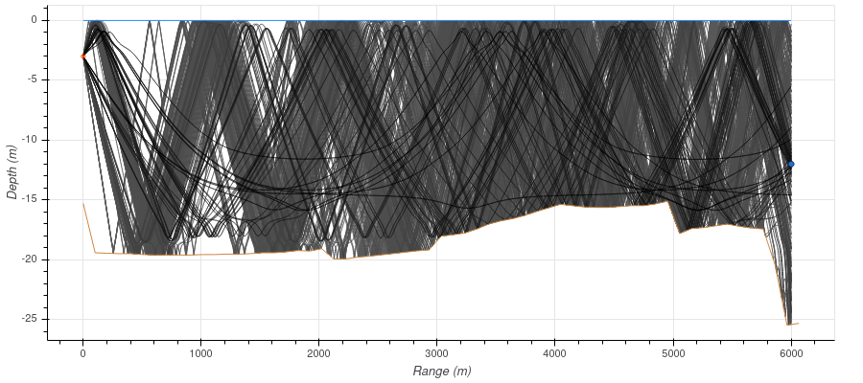
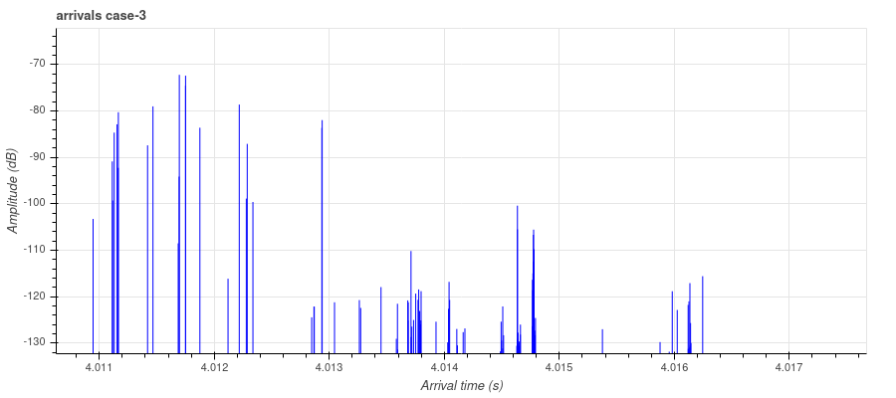
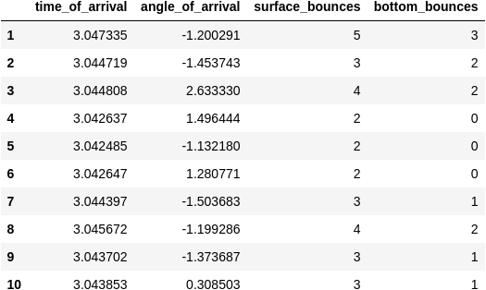
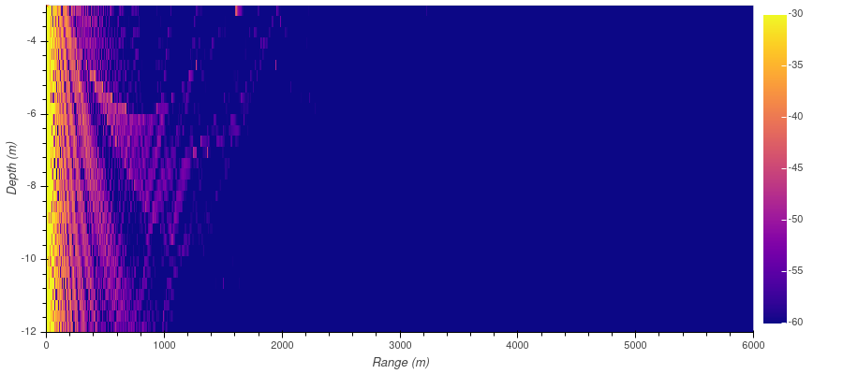
More test cases explored using ARLPY toolbox (4 / 5)
Figure 17: For water depth = 20 m; Tx=3m; Rx= 10m starting from top left corner - i) UW-env; ii) SSP; iii) Eigen rays; iv) arrivals; v) information of first 10 arrivals, and vi) incoherent TL ^{[9]}
Notes:
We had also explored and validate that with the more test cases using ARLPY toolbox which is a python wrapper for Bellhop Toolbox.

Slide 19
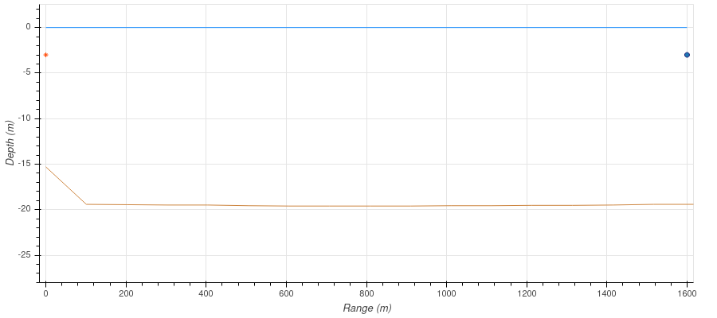
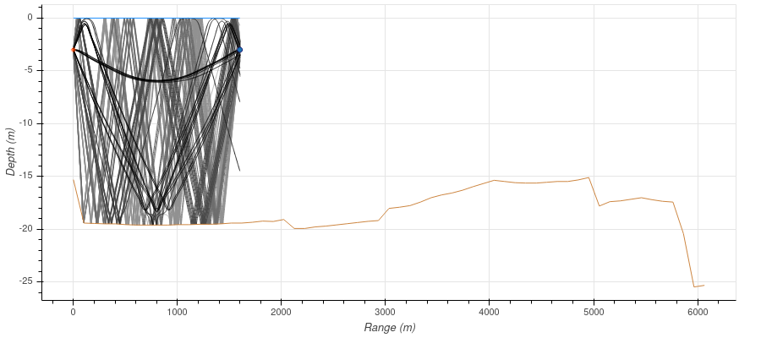
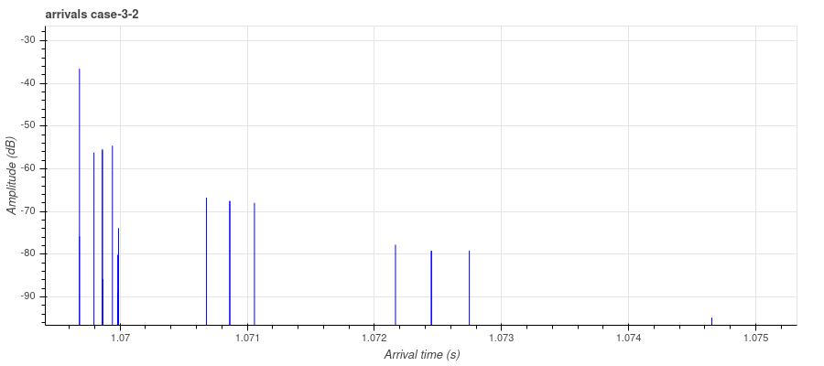
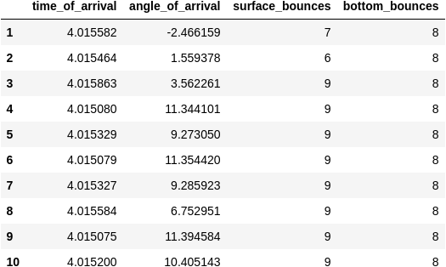
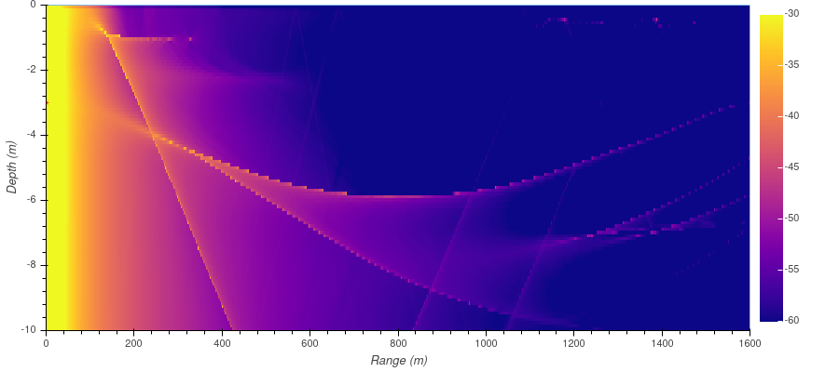
More test cases explored using ARLPY toolbox (5 / 5)
Figure 18: For water depth = 20 m; Tx=3m; Rx= 3m starting from top left corner - i) UW-env; ii) SSP; iii) Eigen rays; iv) arrivals; v) information of first 10 arrivals, and vi) incoherent TL ^{[9]}
Notes:
We had also explored and validate that with the more test cases using ARLPY toolbox which is a python wrapper for Bellhop Toolbox.

Slide 20
Conclusion (1 / 2)
simulating several underwater networks test case, it was observed that for the given environmental conditions, feasible range between UUV and USV as less than or equal to 1.3 km.
this tools were important part of any project in-which a real time uw-network operational range are critical parameter of the mission.
Video 1: Gazebo simulations experimental validation of all 3 marine robots in the.
Notes:
After carefully reviewing all the simulations test cases, we concluded that our operational range is approximately 1.3 Km for given environmental conditions. We also did gazebo simulations to prove the hypothesis, followed by actual in-water testing in Aquatron PoolTank.

Slide 21
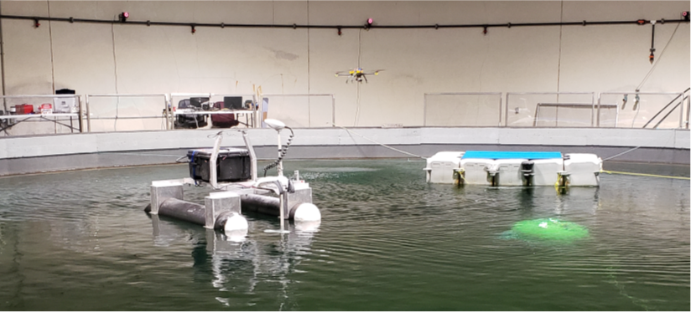
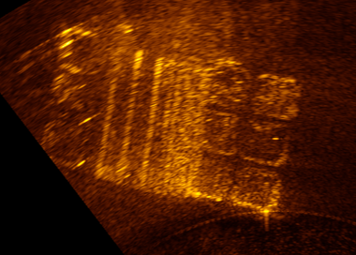
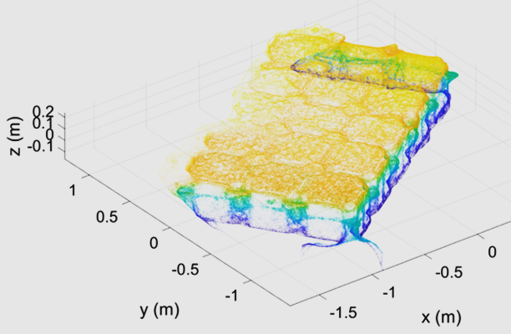
Conclusion (2 / 2)
Integration of hardware-in-loop simulator for multi-domain marine robots may increase the complexity.
Figure 18: All 3 marine robots in the experimental validation.
The USV is left in the foreground. The surfaced UUV is right
in the foreground. The barge is behind both. The UAV is left
of the barge. On the wall, the red LED rings are 3 of the 8
motion capture cameras installed in the Aquatron Pool tank. ^{[6]}
Figure 19: starting from left (a) Flexview sonar imaging of the barge underside from the IMOTUS UUV, (b) Optical camera photogrammetry reconstruction of the barge topside with the Pelican UAV on top of the bottom-side sonar (isometric view).^{[6]}
Notes:
After carefully reviewing all the simulations test cases, we concluded that our operational range is approximately 1.3 Km for given environmental conditions. We also did gazebo simulations to prove the hypothesis, followed by actual in-water testing in Aquatron PoolTank.

Slide 22
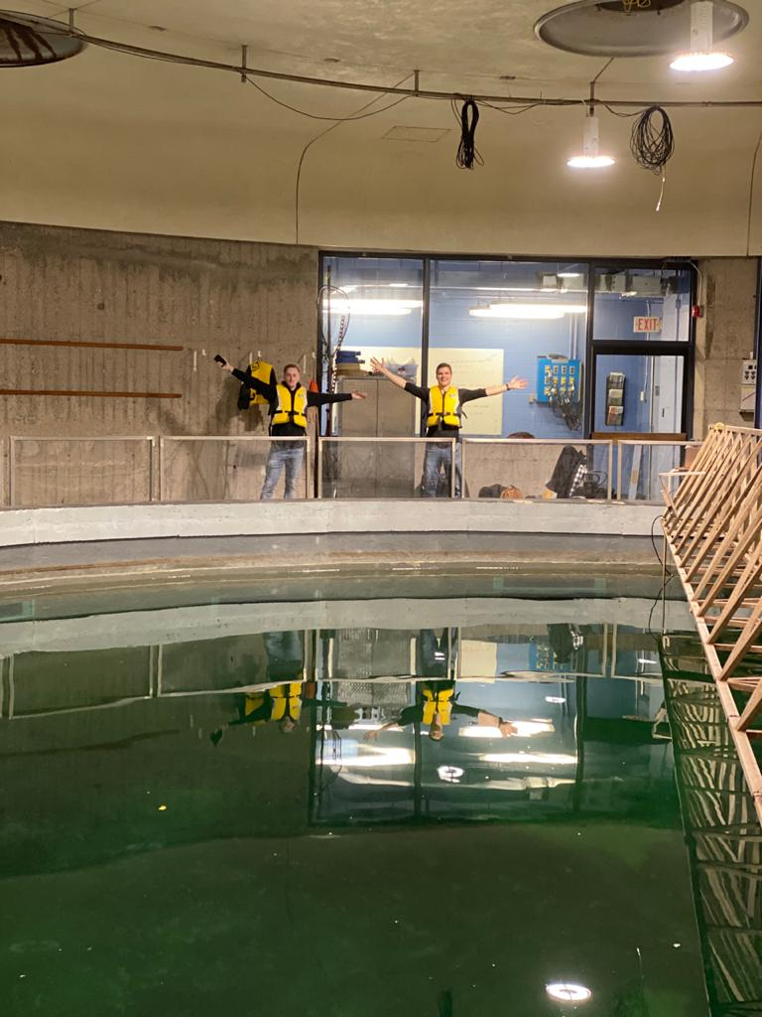

Questions ?
patel.jay@dal.ca
Intelligent Systems Laboratory,
Dalhousie University.

Slide 23
References
Hanjiang Luo, KaishunWu, Rukhsana Ruby, Feng Hong, Zhongwen Guo, and Lionel M. Ni. 2017, “Simulation and experimentation platforms for underwater acoustic sensor networks: Advancements and challenges”, ACM Comput. Surv. 50, 2, Article 28 (May 2017), 44 pages.
Nayyar A., Balas V.E. (2019), “Analysis of Simulation Tools for Underwater Sensor Networks (UWSNs)”, Bhattacharyya S., Hassanien A., Gupta D., Khanna A., Pan I. (eds) International Conference on Innovative Computing and Communications. Lecture Notes in Networks and Systems, vol 55. Springer, Singapore, March 2019 .
D. Pompili, T. Melodia and I. F. Akyildiz, "A CDMA-based Medium Access Control for UnderWater Acoustic Sensor Networks," in IEEE Transactions on Wireless Communications, vol. 8, no. 4, pp. 1899-1909, April 2009.
Hala Jodeh, Aisha Mikkawi, Ahmed Awad, and Othman Othman. 2018, “Comparative analysis of routing protocols for under-water wireless sensor networks”, in Proceedings of the 2nd International Conference on Future Networks and Distributed Systems (ICFNDS '18). ACM, New York, NY, USA, Article 33, 7 pages.
I. Calabrese, R. Masiero, P. Casari, L. Vangelista and M. Zorzi, "Embedded systems for prototyping underwater acoustic networks: The DESERT Underwater libraries on board the PandaBoard and NetDCU," 2012 Oceans, Hampton Roads, VA, 2012, pp. 1-8.

Slide 24
References
J. Ross, J. Lindsay, E. Gregson, A. Moore, J. Patel, and M. Seto. 2019 “Collaboration of multi-domain marine robots towards above and below-water characterization of floating targets”. in IEEE International Symposium on Robotic and Sensors Environments (ROSE), pages 1–7, June 2019.
J. Patel and M. Seto. 2019. “CDMA-based multi-domain communications network for marine robots”, in WUWNET’19: International Conference on Underwater Networks Systems (WUWNET’19), October 23–25, 2019, Atlanta, GA, USA. ACM, New York, NY, USA, 2 pages.
https://www.canada.ca/en/defence-research-development/news/articles/exercise-unmanned-warrior-an-international-exercise-using-autonomous-tech-to-detect-underwater-mines.html
M. Chitre 2020, “ARLPY python toolbox” , https://github.com/org-arl/arlpy

Slide 25
Relevant References from Literature Survey
Sr. No. | Title of the Paper | Author & Publication | Main contribution
1 | Simulation and Experimentation Platforms for Underwater Acoustic Sensor Networks: Advancements and Challenges^{[1]} | Hanjiang Luo, Kaishun Wu, Rukhsana Ruby, Feng Hong, Zhongwen Guo, and Lionel M. Ni. 2017. Simulation and experimentation platforms for underwater acoustic sensor networks: Advancements and challenges. ACM Comput. Surv. 50, 2, Article 28 (May 2017). | This paper would provide a brief analysis of various simulators available in the market right now with their pros and cons and provide components to develop simulation and experimentation platforms and provide a comprehensive survey report in this area and based on some typical criteria, provide useful guidelines for researchers on choosing suitable platforms in accordance with their requirements.

Slide 26
Relevant References from Literature Survey
Sr. No. | Title of the Paper | Author & Publication | Main contribution
2 | Analysis of Simulation Tools for Underwater Sensor Networks (UWSNs)^{[2]} | Nayyar, Anand & Balas, Valentina, - Bhattacharyya S., Hassanien A., Gupta D., Khanna A., Pan I. (eds) International Conference on Innovative Computing and Communications. Lecture Notes in Networks and Systems, vol 55. Springer, Singapore,2019. | This paper in-depth analysis of various UWSN simulation tools along with the performance comparison and key features associated with it. The paper also assists researchers to select the best available tool and highlights research directions to inherit advanced Features in UWSN simulators to perform advanced real-time underwater simulations.

Slide 27
Relevant References from Literature Survey
Sr. No. | Title of the Paper | Author & Publication | Main contribution
3 | A CDMA-Based Medium Access Control for Underwater Acoustic Sensor Networks^{[3]} | D. Pompili, T. Melodia and I. F. Akyildiz, in IEEE Transactions on Wireless Communications, vol. 8, no. 4, pp. 1899-1909, April 2009. | This paper has proposed transmitter-based Code Division Multiple Access (CDMA) for deep water without considering the near far affect. It doesn’t provide any information about how this protocol would react under shallow water conditions.

Slide 28
Relevant References from Literature Survey
Sr. No. | Title of the Paper | Author & Publication | Main contribution
4 | Comparative Analysis of Routing Protocols for Under-Water wireless Sensor Networks^{[4]} | Hala Jodeh, Aisha Mikkawi, Ahmed Awad, and Othman Othman - in Proceedings of the 2nd International Conference on Future Networks and Distributed Systems (ICFNDS '18). ACM, New York, NY, USA, Article 33, 7 pages,2018. | This paper illustrate performance analysis of three classical location-based routing protocols (namely, VBF, HH-VBF, and VBVA) for underwater wireless sensor networks in terms of three critical performance metrics which includes energy consumption, end-to-end delay, and packet delivery ratio. This study will provide excellent candidates for underwater routing protocols.

Slide 29
Relevant References from Literature Survey
Sr. No. | Title of the Paper | Author & Publication | Main contribution
5 | Embedded Systems for Prototyping Underwater Acoustic Networks: the DESERT Underwater Libraries on board the PandaBoard and NetDCU^{[5]} | I. Calabrese, R. Masiero, P. Casari, L. Vangelista and M. Zorzi- in 2012 Oceans, Hampton Roads, VA, 2012, pp. 1-8. | This paper illustrate process to transfer ns2 simulation on various embedded computer boards such as PandaBoard and NetDCU. It also provide supportive information on how to install NS, NS-Miracle libraries and DESERT Underwater libraries on board.

Slide 30
Relevant References from Literature Survey
Sr. No. | Title of the Paper | Author & Publication | Main contribution
6 | Embedded Systems for Prototyping Underwater Acoustic Networks: the DESERT Underwater Libraries on board the PandaBoard and NetDCU^{[5]} | I. Calabrese, R. Masiero, P. Casari, L. Vangelista and M. Zorzi- in 2012 Oceans, Hampton Roads, VA, 2012, pp. 1-8. | This paper illustrate process to transfer ns2 simulation on various embedded computer boards such as PandaBoard and NetDCU. It also provide supportive information on how to install NS, NS-Miracle libraries and DESERT Underwater libraries on board.

